Slide 1

Regional Climate Dynamics and Extreme Events
Ayenew Desalegn
03.07.2024

Slide 2
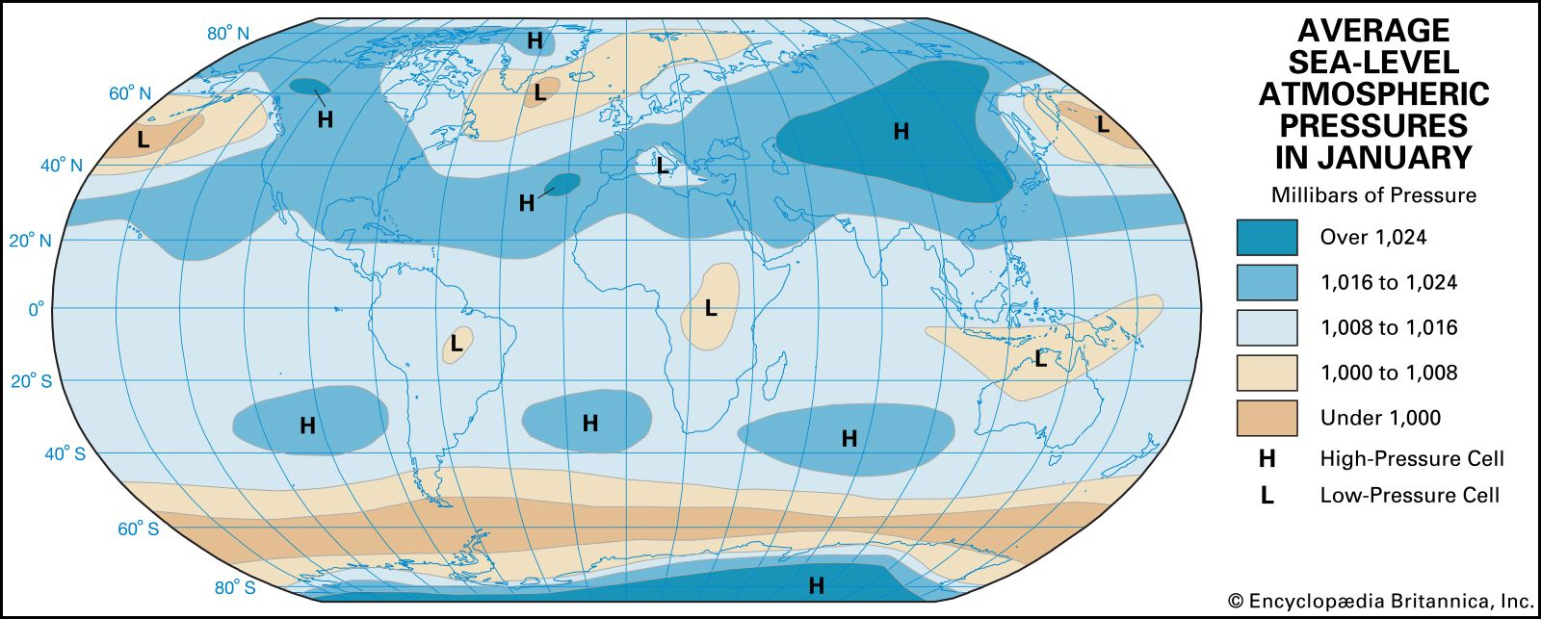
Climate dynamics
Climate dynamics refers to the complex, interrelated processes that govern the Earth's climate system.
Atmosphere
Biosphere
Lithosphere
Hydrosphere
Cryosphere
Introduction | Motivation | Objectives | Methods
Notes:
Atmosphere:
The atmosphere is the most dynamic component, constantly in motion, redistributing heat, moisture, and pollutants around the globe.
Processes include the formation of weather systems, the development of pressure systems, and large-scale circulation patterns like the Hadley cell, Ferrel cell, and polar vortex.
Oceans:
Oceans play a critical role in storing and redistributing heat. Ocean currents, such as the Gulf Stream and the thermohaline circulation, move warm and cold water around the globe.
Oceans also influence the atmosphere through heat exchange, evaporation, and the formation of sea ice.
Cryosphere:
The cryosphere includes all frozen water parts of the Earth, such as glaciers, ice caps, and sea ice.
Changes in the cryosphere, such as melting glaciers and ice sheets, affect sea levels and albedo (reflectivity), which in turn influence global temperatures.
Biosphere:
The biosphere encompasses all living organisms and their interactions with the climate system.
Vegetation influences the climate through processes like transpiration and carbon sequestration. Changes in land use, such as deforestation, can significantly impact local and global climate dynamics.
Lithosphere:
The lithosphere refers to the Earth's surface and its geological processes, including volcanic activity, which can release significant amounts of greenhouse gases and aerosols into the atmosphere.

Slide 3
Climate Variability and Change
In recent years, there has been an increase in the frequency and intensity of extreme weather events ( Drought, flood, heatwaves ….)
Understanding climate dynamics is crucial to identify and predict localized climatic changes and their impacts.
Introduction | Motivation | Objectives | Methods

Slide 4
Climate data often exhibit non-stationary behavior
Non-stationary data can impact the accuracy of climate models.
Traditional statistical models often assume stationarity, meaning they assume the statistical properties of the data (mean, variance) remain constant over time.
However, climate data often violate this assumption due to trends, seasonality, and varying variability.
Recognizing non-stationarity allows scientists to use more sophisticated models (e.g., ARIMA, GARCH, machine learning models) that can handle these complexities and improve predictions.
Introduction | Motivation | Objectives | Methods | Results | conclusion

Slide 5
To identify climate system change
To analyze climate patterns and their changes over time
To identify the frequency and intensity of extreme weather events
To understand the main controlling factors of the climate dynamics and extreme events
Introduction | Motivation | Objectives | Methods | Results | Outlooks

Slide 6
Datasets Required for Climate Dynamics Analysis
Category | Variables | Possible Sources
Atmospheric Data | - Temperature (surface, upper air) | - NOAA, ECMWF, NASA
 | - Pressure (surface, sea level) | - Reanalysis datasets (ERA5, NCEP/NCAR)
 | - Humidity (specific, relative) | - Weather stations, satellite data
 | - Wind (speed, direction) | - Wind profilers, radiosondes
 | - Precipitation (rainfall, snowfall) | - Global Precipitation Measurement (GPM)
Oceanic Data | - Sea Surface Temperature (SST) | - NOAA, Hadley Centre, ECMWF
Aerosols & Gases | - Aerosol Concentration (distribution, types) | - AERONET, MODIS, CALIPSO
 | - Greenhouse Gases (CO2, CH4, N2O) | - NOAA, Mauna Loa Observatory, GOSAT
 | - Ozone (stratospheric, tropospheric) | - OMI, MLS, ground-based observations
Climate Indices | - ENSO (NINO indices, SOI) | - NOAA, BOM, CPC
 | - AMO (AMO index) | - NOAA, Kaplan SST
 | - IOD (IOD index), EPTW, Zonal wind | - JAMSTEC, BOM
 | - AO (AO index) | - NOAA, CPC
 | - NAO (NAO index) | - NOAA, CPC
43 years data
Introduction | Motivation | Objectives | Methods | Results | Outlooks
Notes:
AMOC (Average or Automated Change Detection):
Description: AMOC is a simpler method that detects a single change point by comparing the average of the data segments before and after the change point.
Application: Suitable for detecting a single change point in a dataset.
PELT (Pruned Exact Linear Time):
Description: PELT is an advanced and efficient method for detecting multiple change points. It uses dynamic programming to optimize the search process and prunes unnecessary computations to improve efficiency.
Application: Suitable for detecting multiple change points in large datasets.
Procedure:
Define a cost function that balances the fit of the model with the number of change points.
Use dynamic programming to find the set of change points that minimizes this cost function.
Prune the search space to reduce computational complexity.

Slide 7
+-------------------------------------+
| Objective One |
| Change Point Detection|
+-------------------------------------+
+-------------------------------------+
| Objective Two |
| Analyze Climate Pattern
+-------------------------------------+
+-------------------------------------+
| Objective Three |
| Identify Extreme Events |
+-------------------------------------+
+-------------------------------------+
| Objective Four |
| Identify Primary Factors|
+-------------------------------------+
+-------------------------------------------------------------------------------------------+
Method
- machine learning method
- Change Point Detection
- Validate change points
+-------------------------------------------------------------------------------------------+
AMOC, PELT, SegNeigh or BinSeg
+-------------------------------------------------------------------------------------------+
Method
- Use time series analysis
- Apply clustering techniques
- Identify trends and patterns
+--------------------------------------------------------------------------------------------+
NN, MLP, LSTM, NBEATS, NHITS
+-------------------------------------------------------------------------------------------+
Method
- Use statistical thresholds or
machine learning techniques
+--------------------------------------------------------------------------------------------+
BM
POT
EVA GEVD
GPD
+--------------------------------------------------------------------------------------------+
Method
- machine learning methods
+--------------------------------------------------------------------------------------------+
Copula
Random Forest
SHAP Values
Introduction | Motivation | Objectives | Methods | Results | Outlooks
Notes:
The full name of LSTM is "Long Short-Term Memory". It is a type of recurrent neural network (RNN) architecture that is designed to overcome the vanishing gradient problem and better capture long-term dependencies in sequential data. LSTMs have been widely used in various applications such as natural language processing, time series prediction, speech recognition, and more, due to their ability to maintain and propagate information over long sequences.

Slide 8
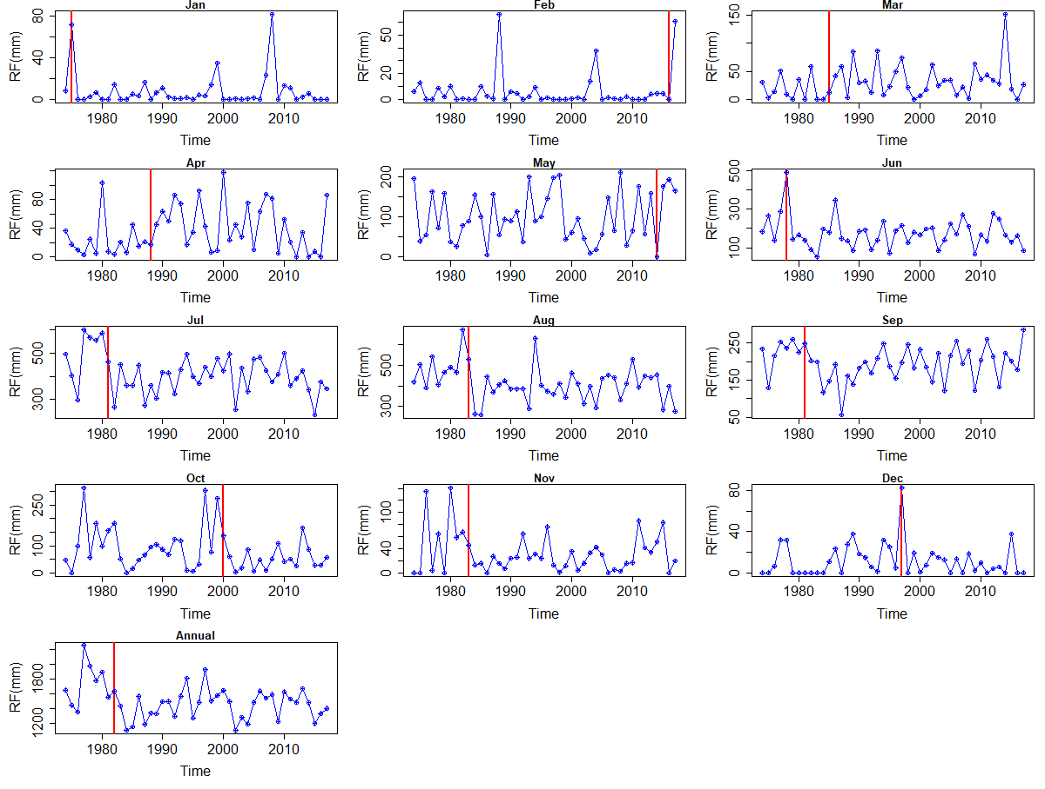
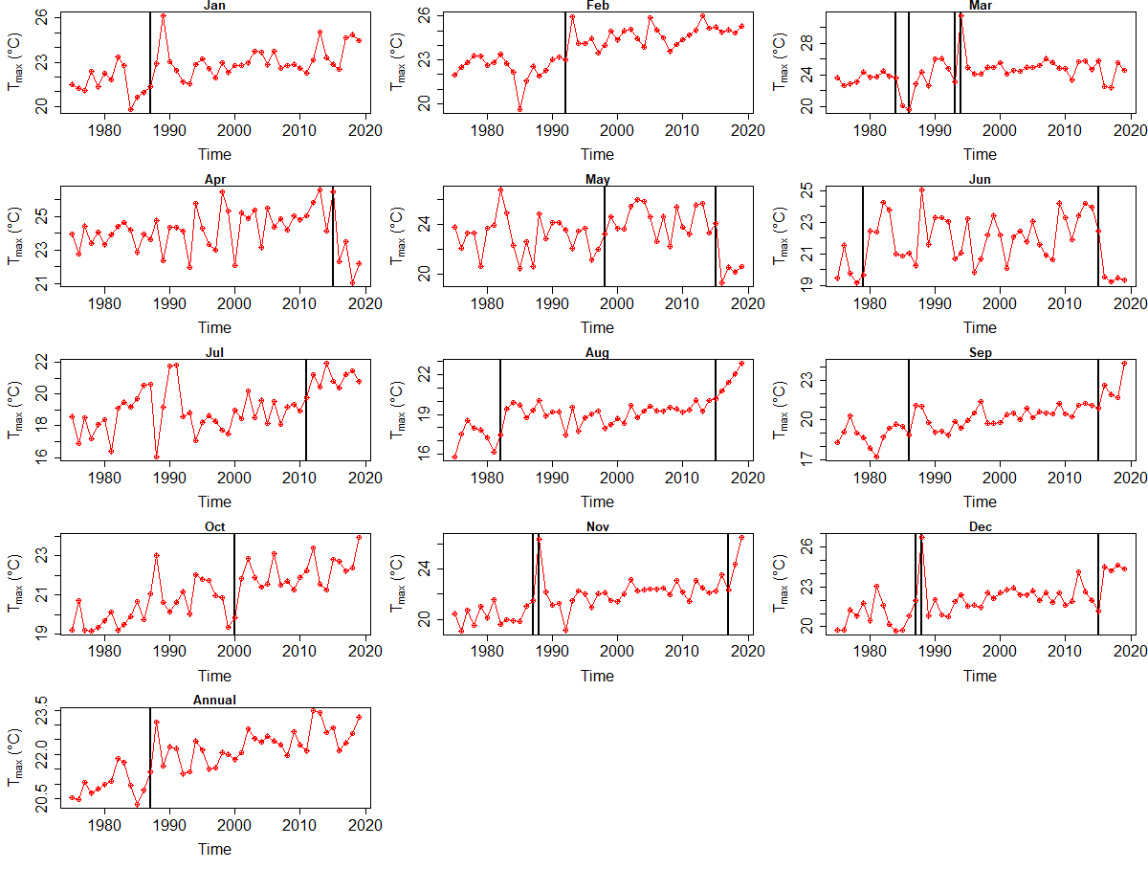
Change points detection
The rainfall has changed after 1983
= decreasing trend
The Temp. has changed after 1987
= increasing trend
The climate system of the region has changed after 1983.
Introduction | Motivation | Objectives | Methods | Results | Outlooks

Slide 9
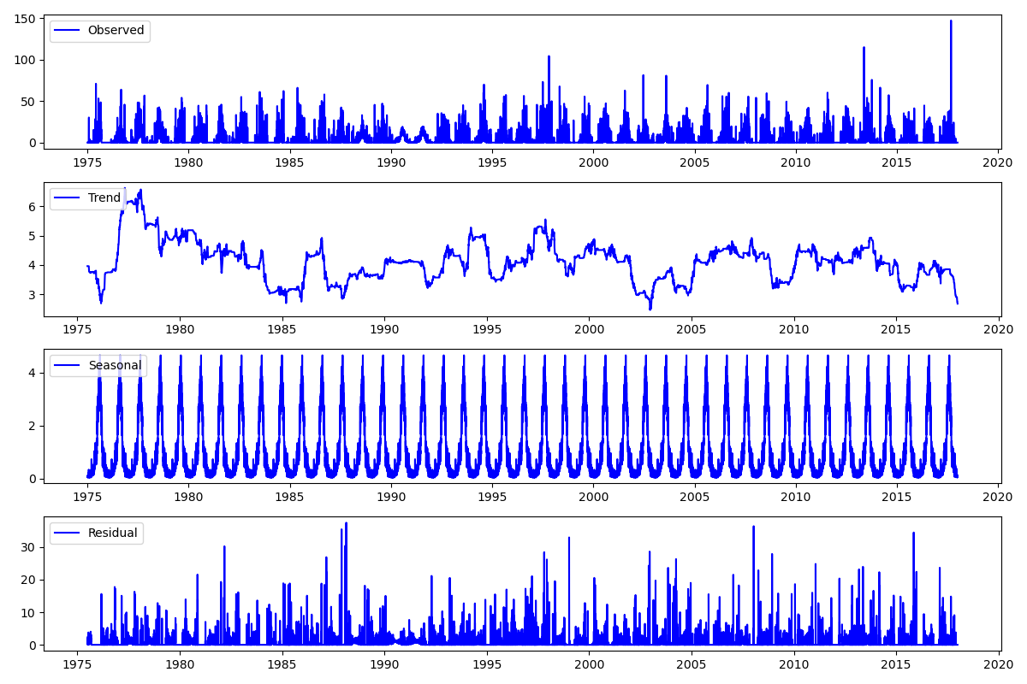
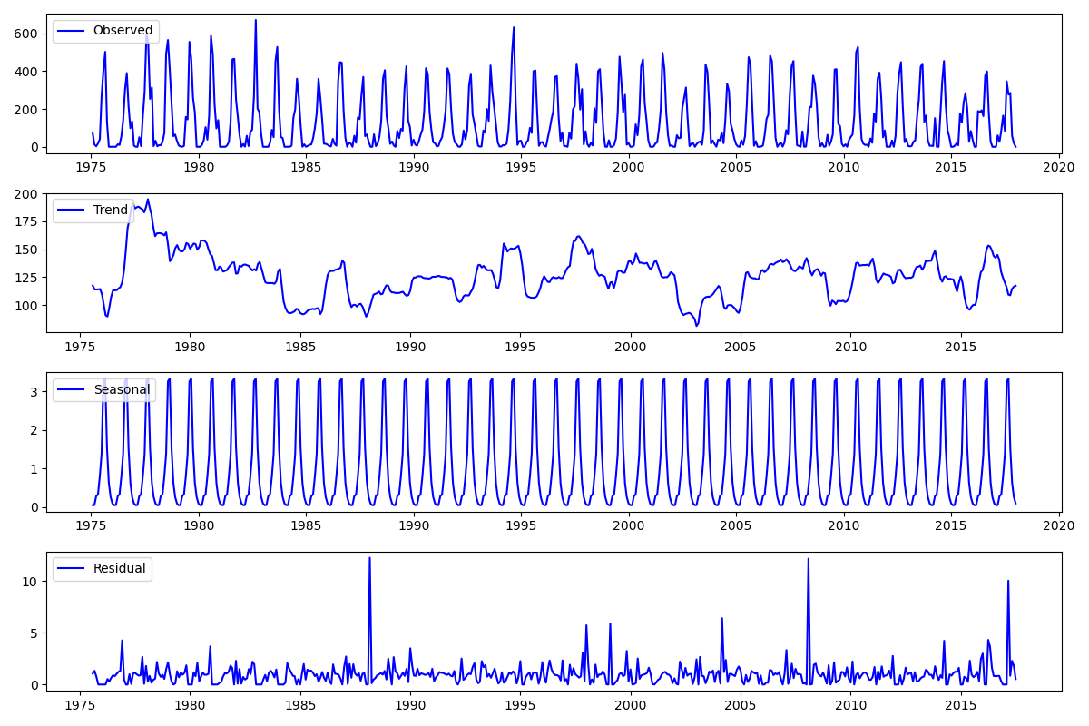
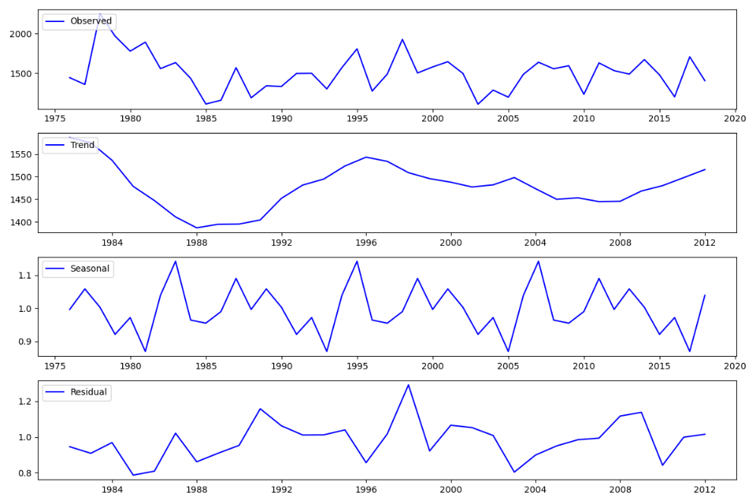
Climate Pattern – Precepitation
Multiplicative Decomposition, MSE = 8.1
Daily data
Multiplicative Decomposition, MSE = 2.4
Monthly data
Multiplicative Decomposition, MSE = 0.97
Annual data
Introduction | Motivation | Objectives | Methods | Results | Outlooks
Notes:
Mean Squared Error of Additive Model (Precipitation): 43.53585855392756
Mean Squared Error of Multiplicative Model (Precipitation): 8.091014108032832

Slide 10
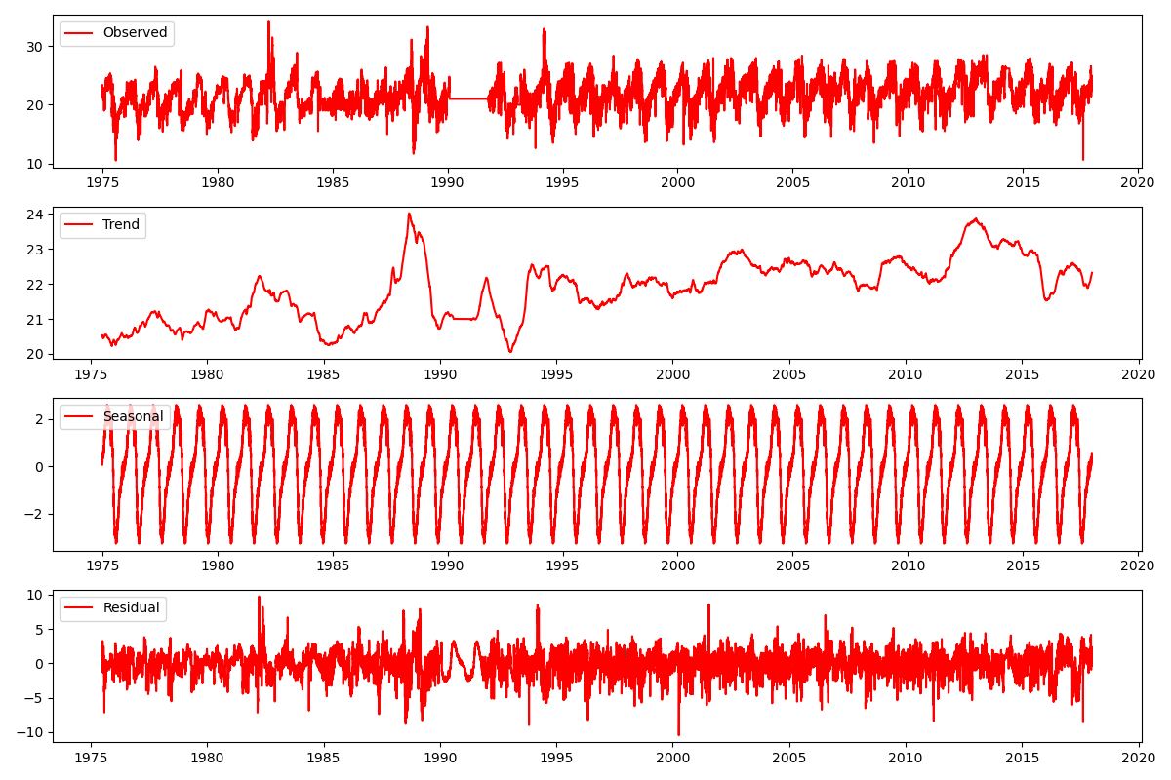
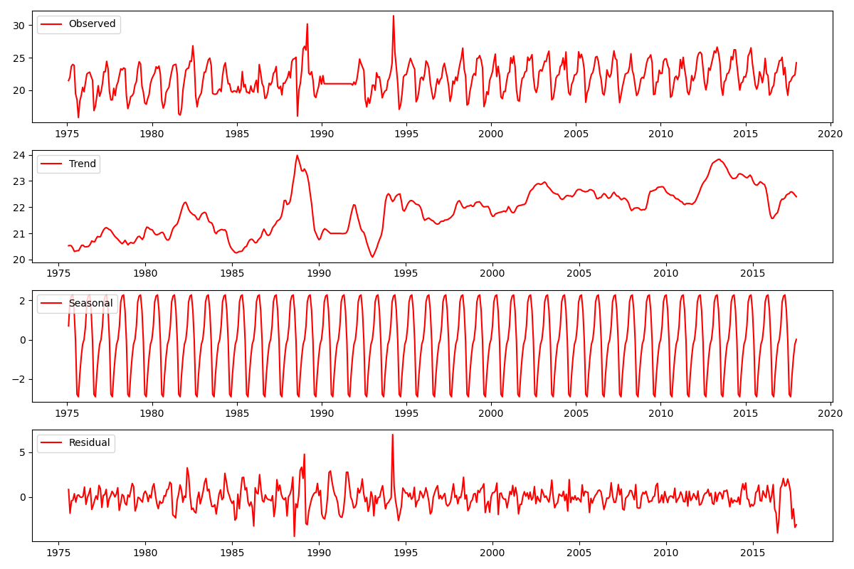
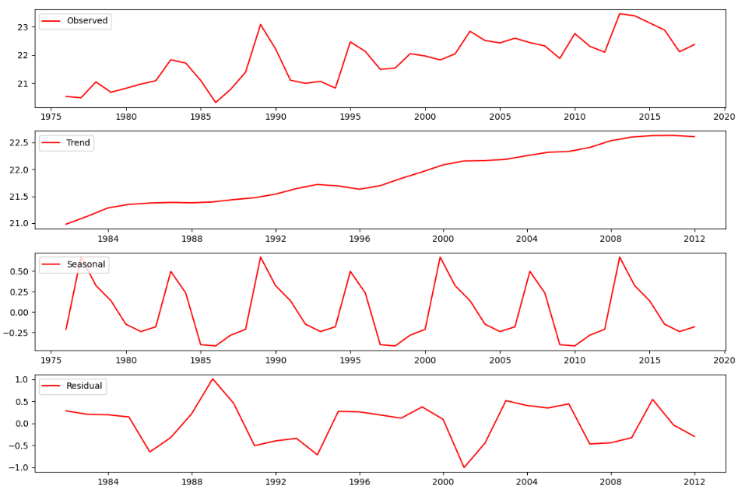
Climate Pattern-Temperature
Additive Decomposition, MSE =0.2
Annual data
Additive Decomposition, MSE = 2.8
Daily data
Additive Decomposition, MSE = 1.3
Monthly data
Introduction | Motivation | Objectives | Methods | Results | Outlooks
Notes:
Mean Squared Error of Additive Model (Temperature): 2.844748672811345
Mean Squared Error of Multiplicative Model (Temperature): 1.005899824630623

Slide 11
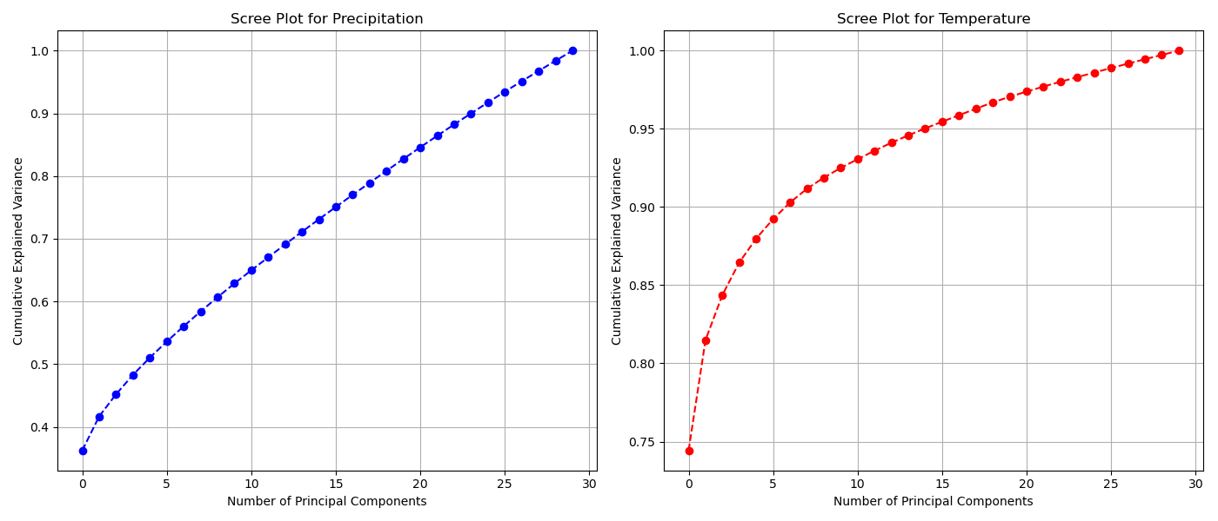
Climate variability-PCA identification- Scree plot
Introduction | Motivation | Objectives | Methods | Results | Outlooks

Slide 12
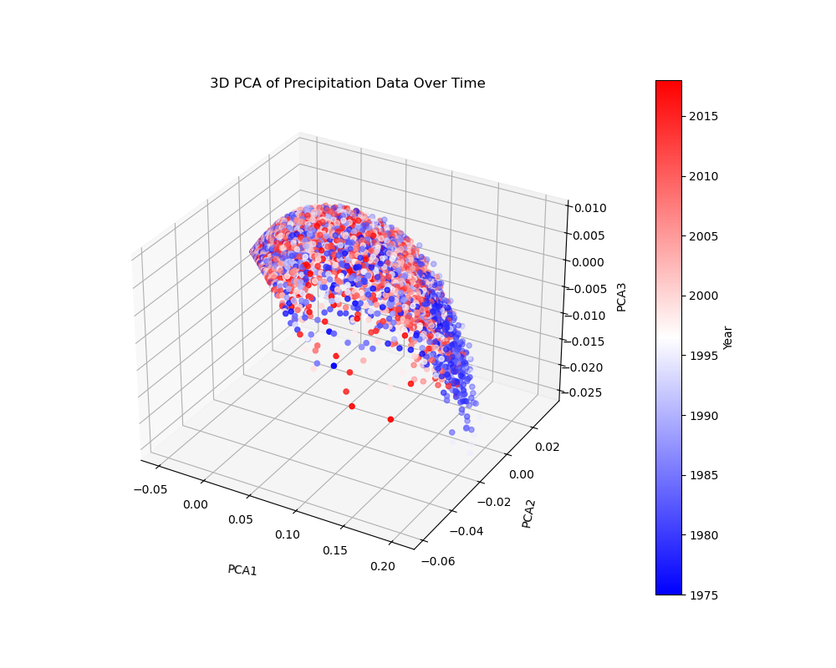
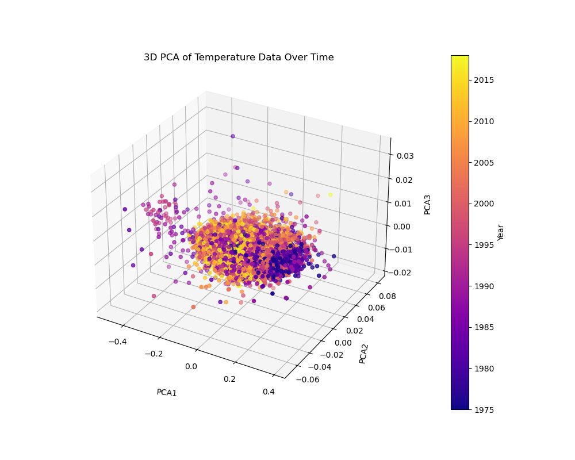
Climate variability
Introduction | Motivation | Objectives | Methods | Results | Outlooks

Slide 13
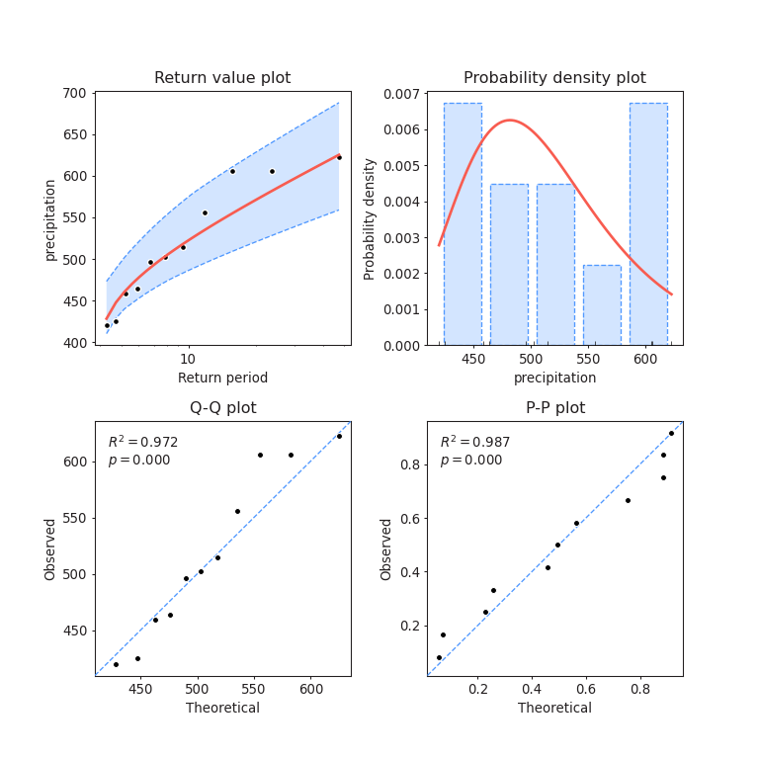
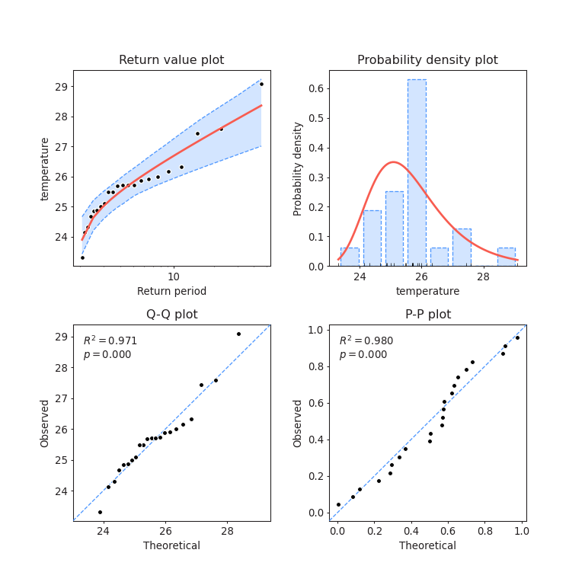
Climate Variability
Introduction | Motivation | Objectives | Methods | Results | Outlooks

Slide 14
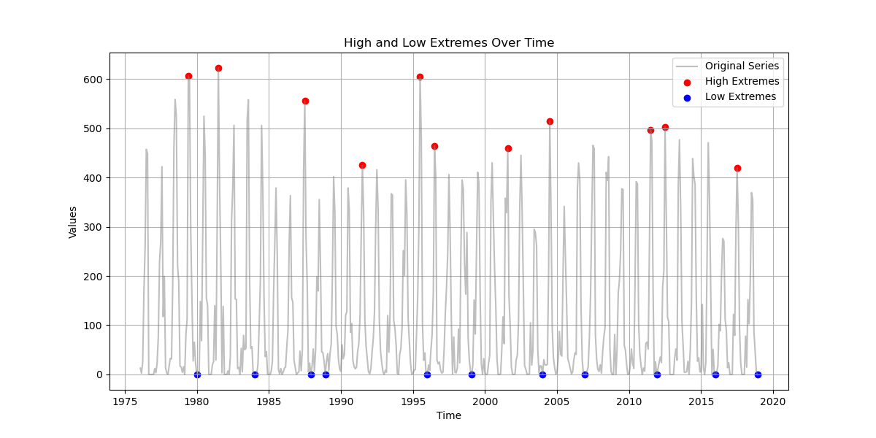
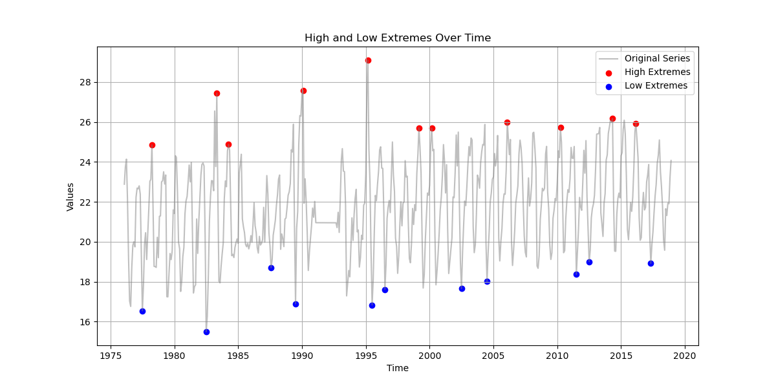
Identify Extreme Events- BM method
Precipetation
Temperature
Block size = 4 years
Introduction | Motivation | Objectives | Methods | Results | Outlooks

Slide 15
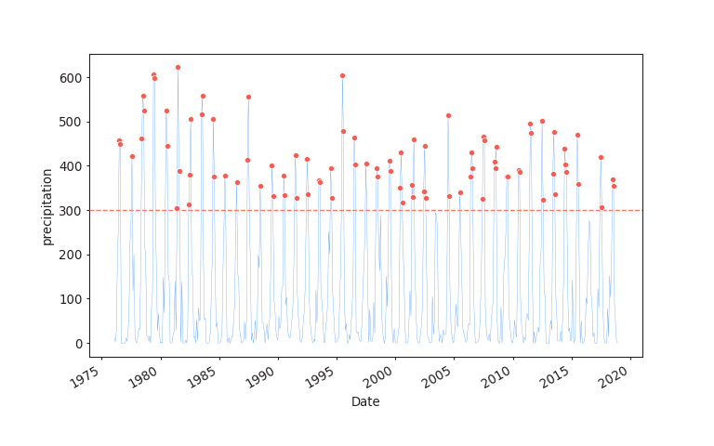
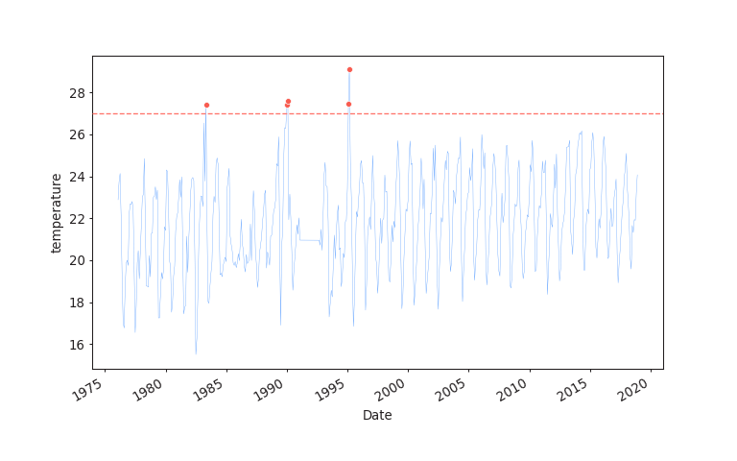
Identify Extreme Events: POT method
Treshold= 300mm
Treshold= 27 ºc
Introduction | Motivation | Objectives | Methods | Results | Outlooks

Slide 16
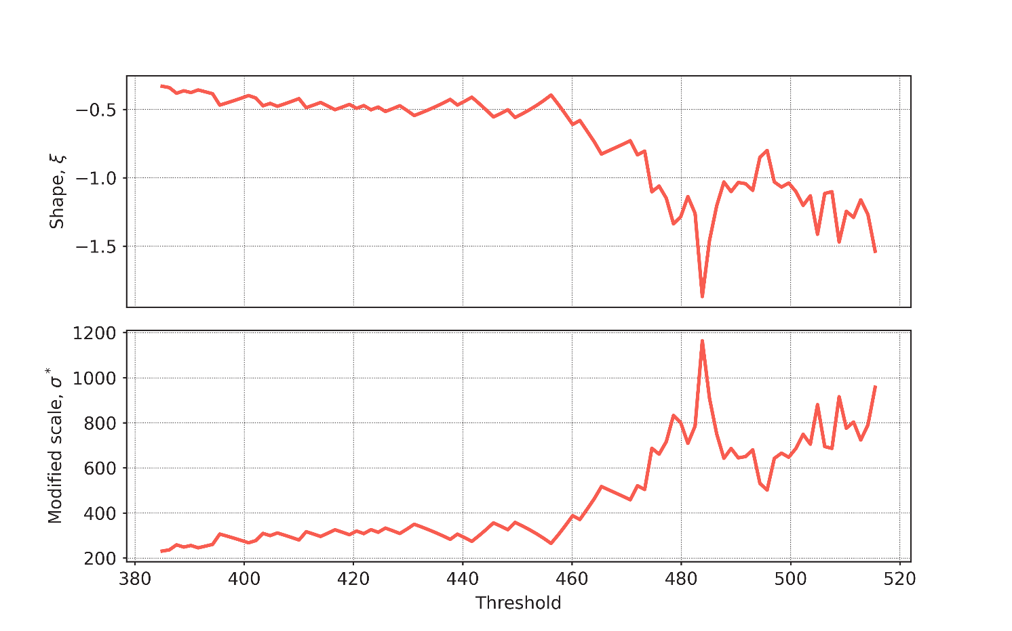
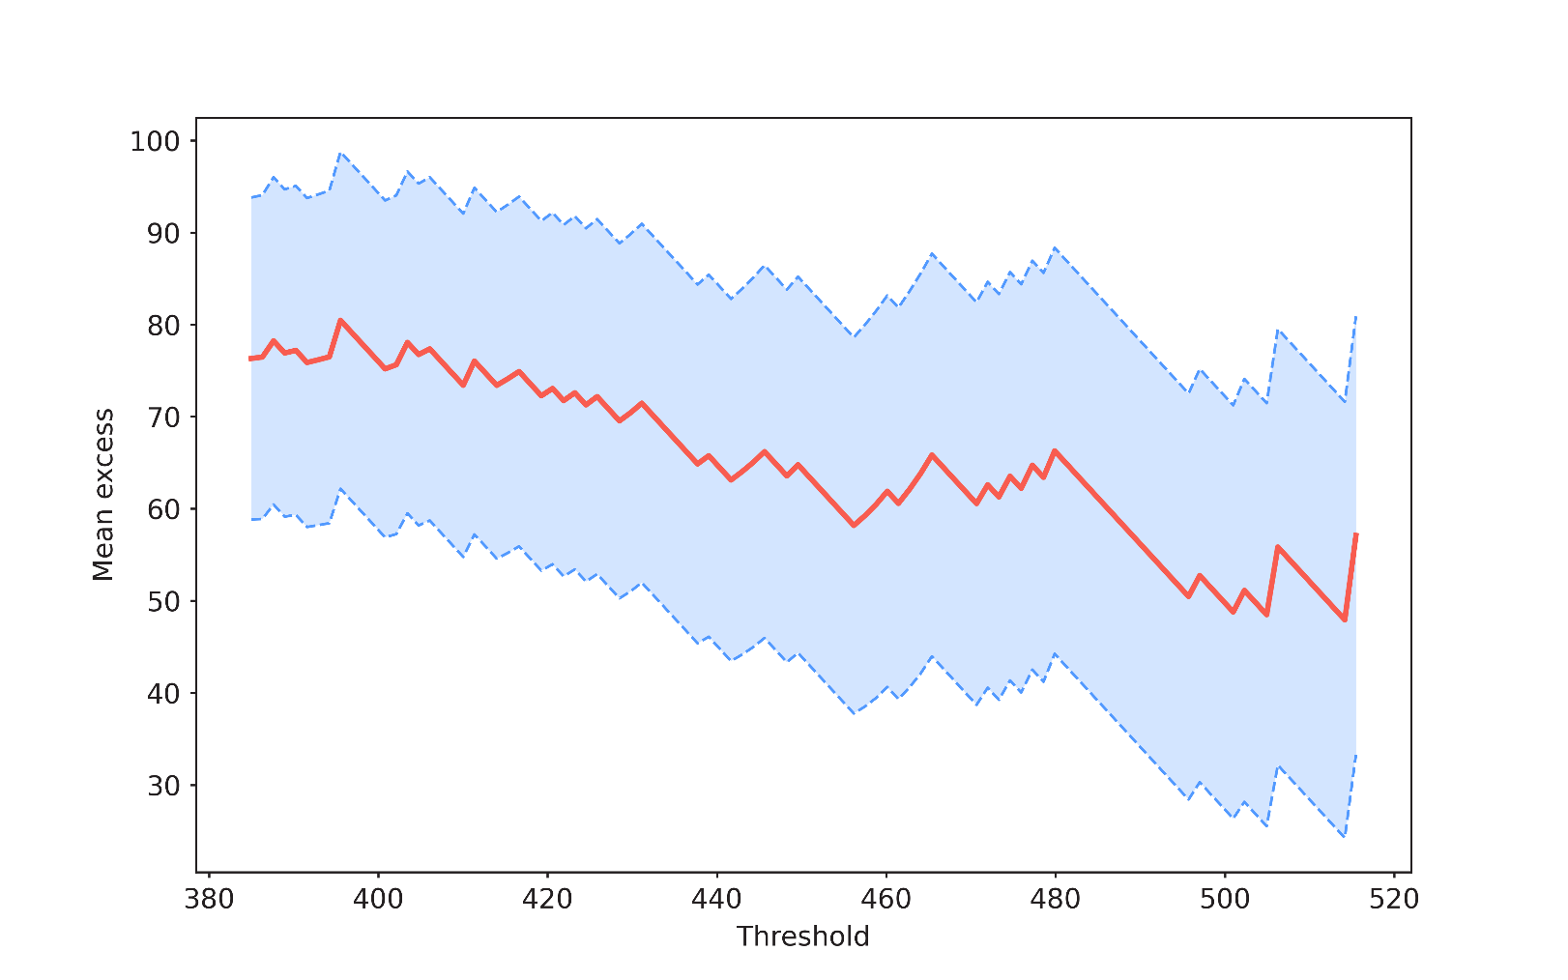
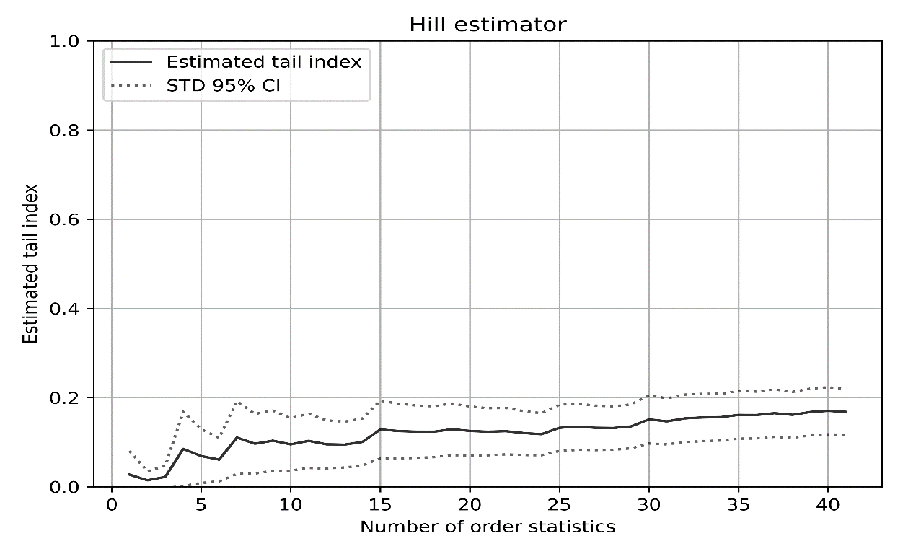
Threshold investigation
Notes:
= Mean Residual Life
= Parameter Stability
= hill estimator

Slide 17
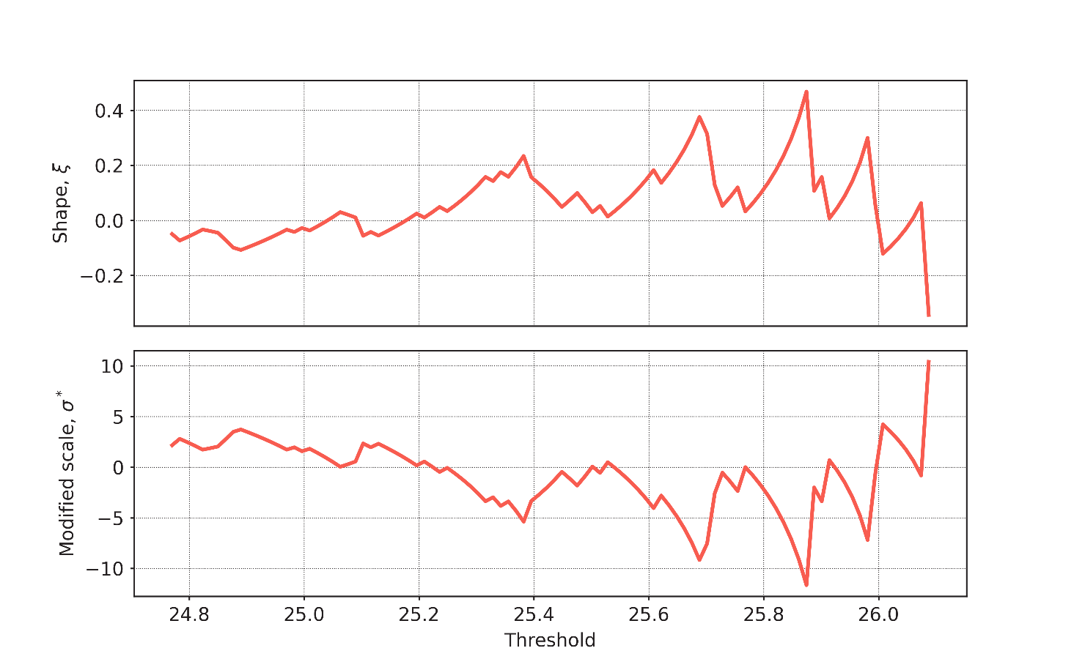
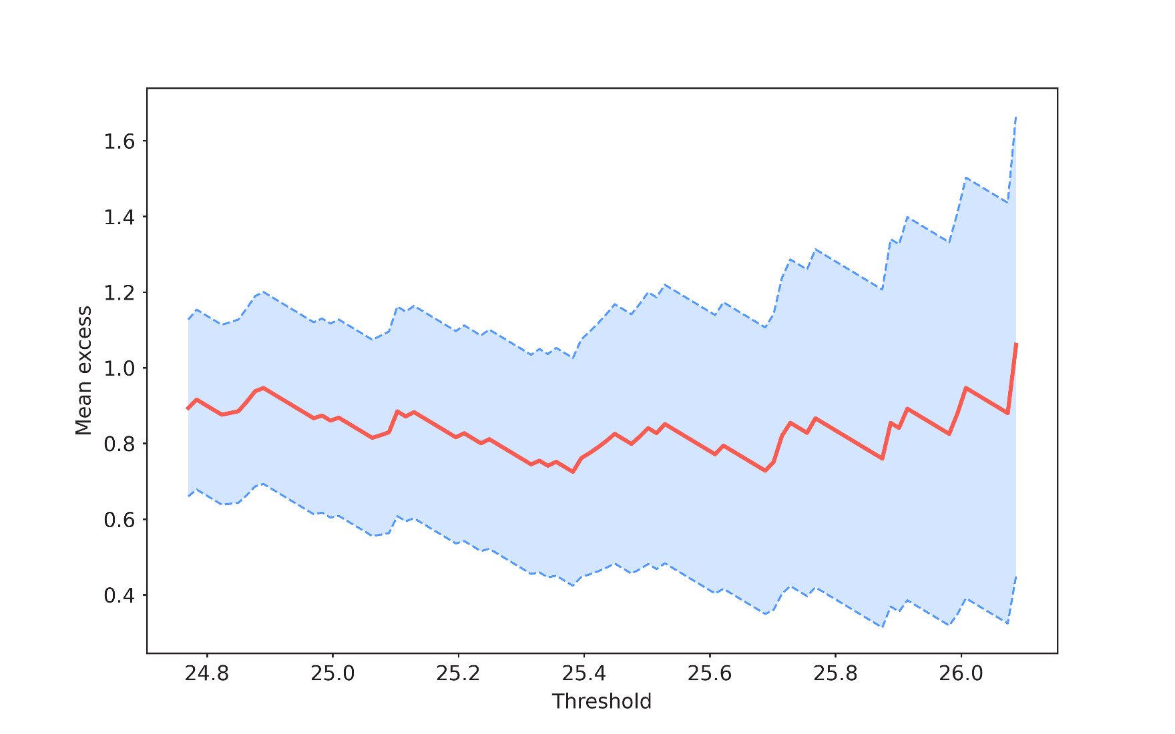
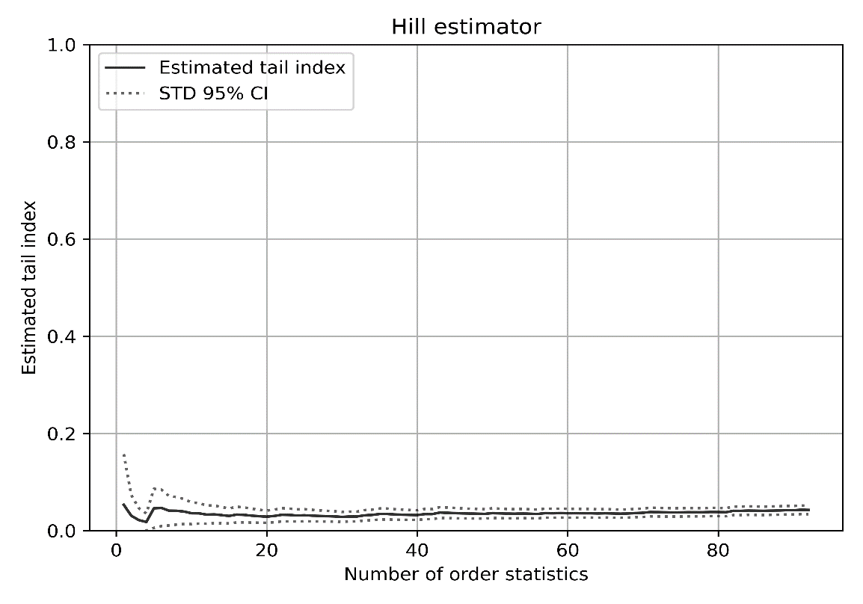
Threshold investigation

Slide 18
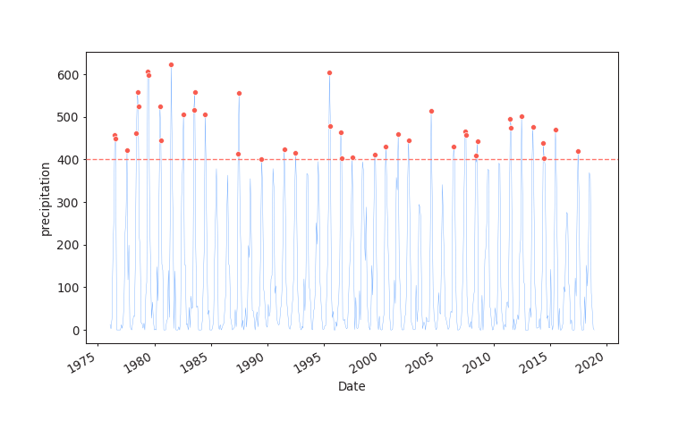
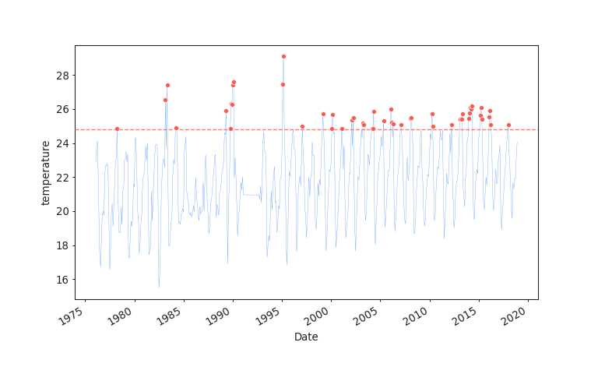
Treshold= 400mm
Treshold= 24.8 ºc

Slide 19
Wavelet Transform- PCP
Annomalies detected
1975-1981 - high
2013-2017 - low
Introduction | Motivation | Objectives | Methods | Results | Outlooks

Slide 20
Wavelet Transform- Temp
Annomalies detected
1975-1980 -low
2013-2017 - high
Introduction | Motivation | Objectives | Methods | Results | Outlooks

Slide 21
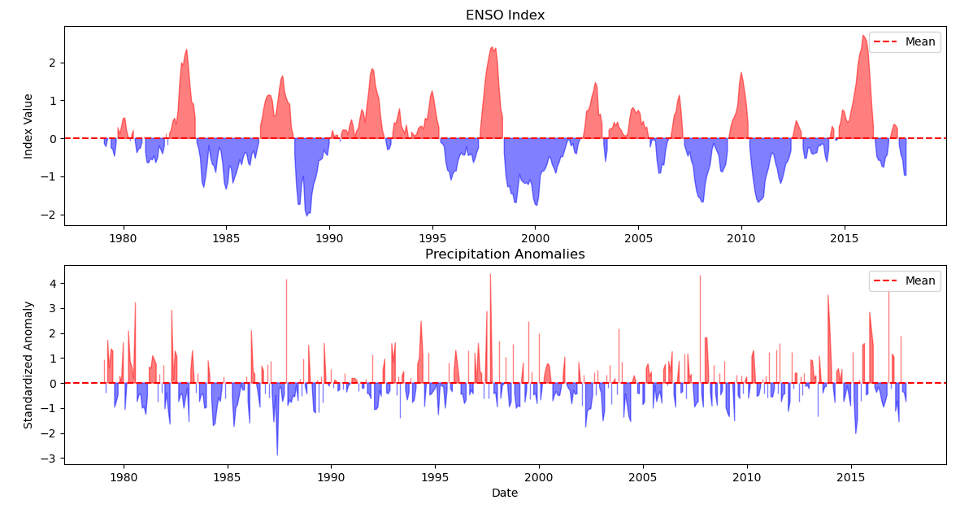
Best lag: 4 months, Maximum correlation: 0.03
Introduction | Motivation | Objectives | Methods | Results | Outlooks

Slide 22
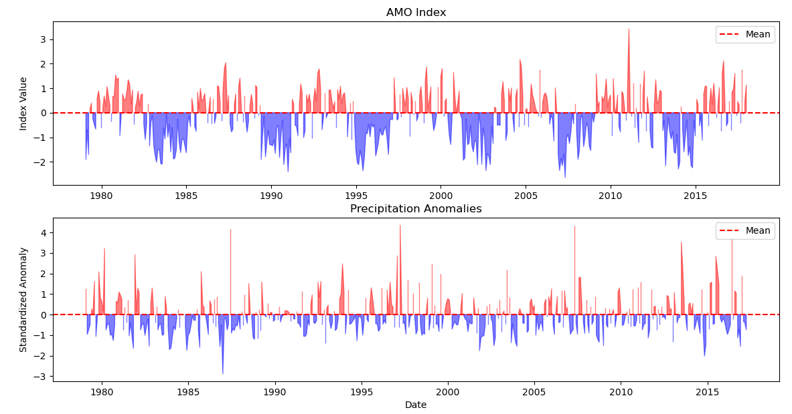
Best lag: 9 months , Maximum correlation: 0.11
Introduction | Motivation | Objectives | Methods | Results | Outlooks

Slide 23
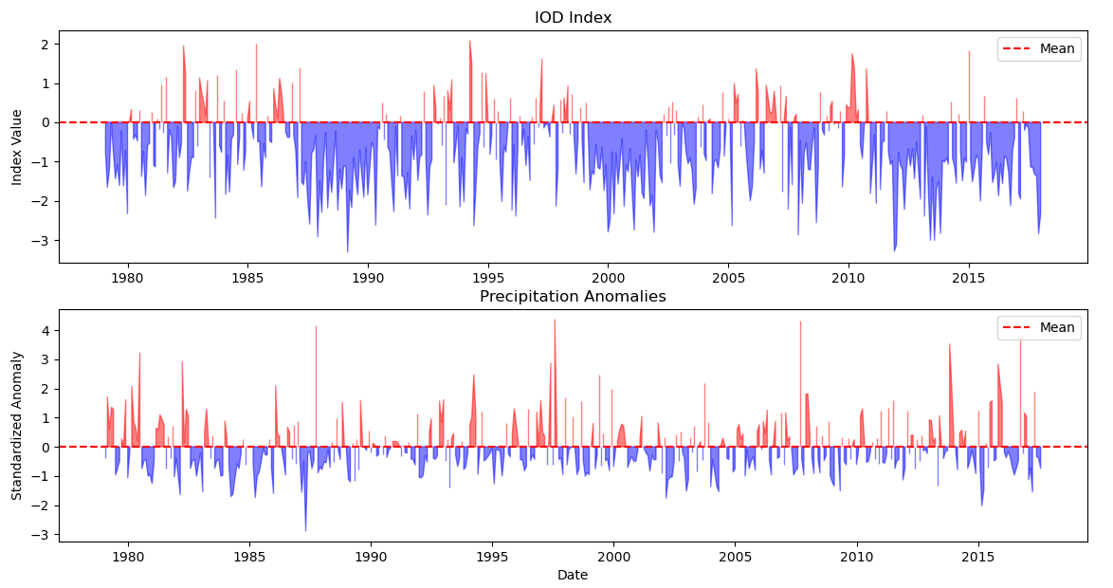
Best lag: 5 months, Maximum correlation: 0.09
Introduction | Motivation | Objectives | Methods | Results | Outlooks

Slide 24
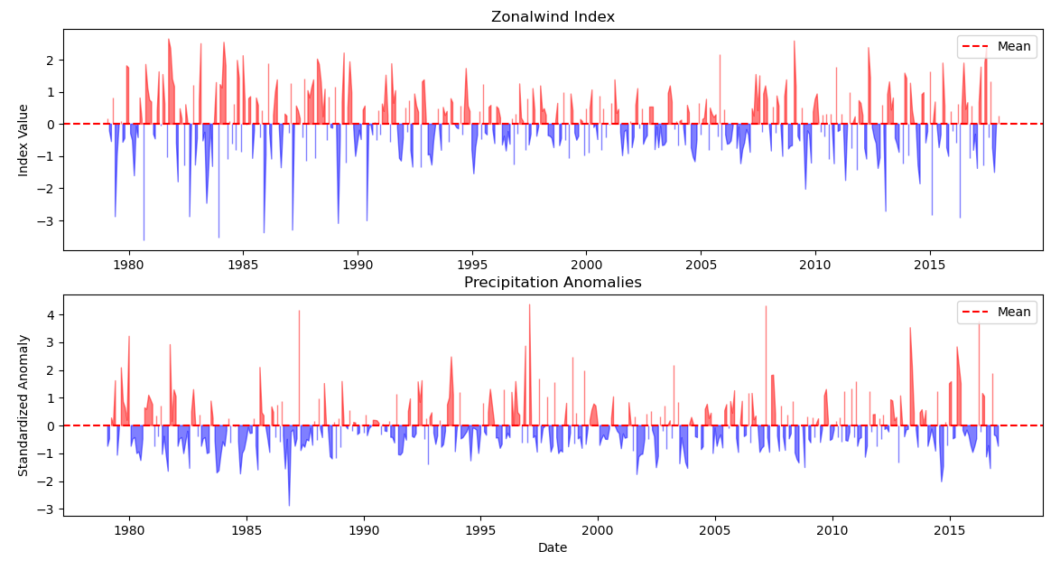
Best lag: 11 months, Maximum correlation: 0.05
Introduction | Motivation | Objectives | Methods | Results | Outlooks

Slide 25
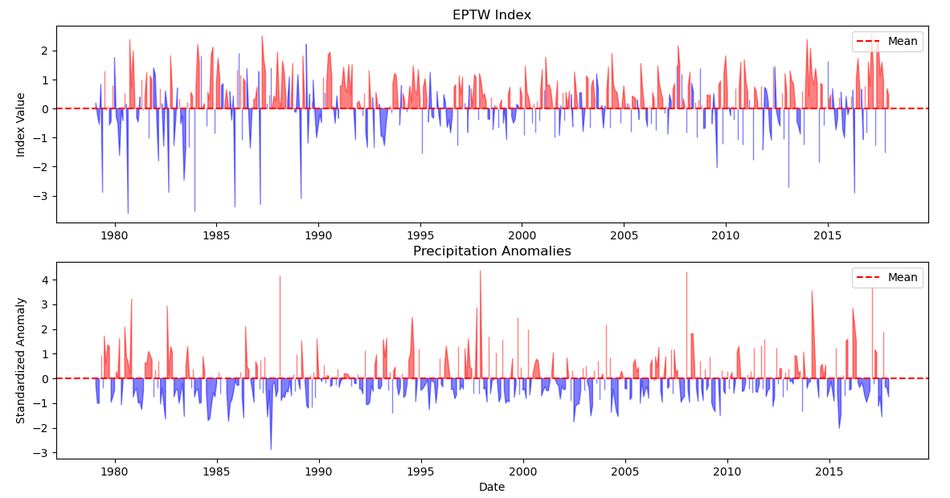
Best lag: 1 months, Maximum correlation: 0.04
Introduction | Motivation | Objectives | Methods | Results | Outlooks

Slide 26
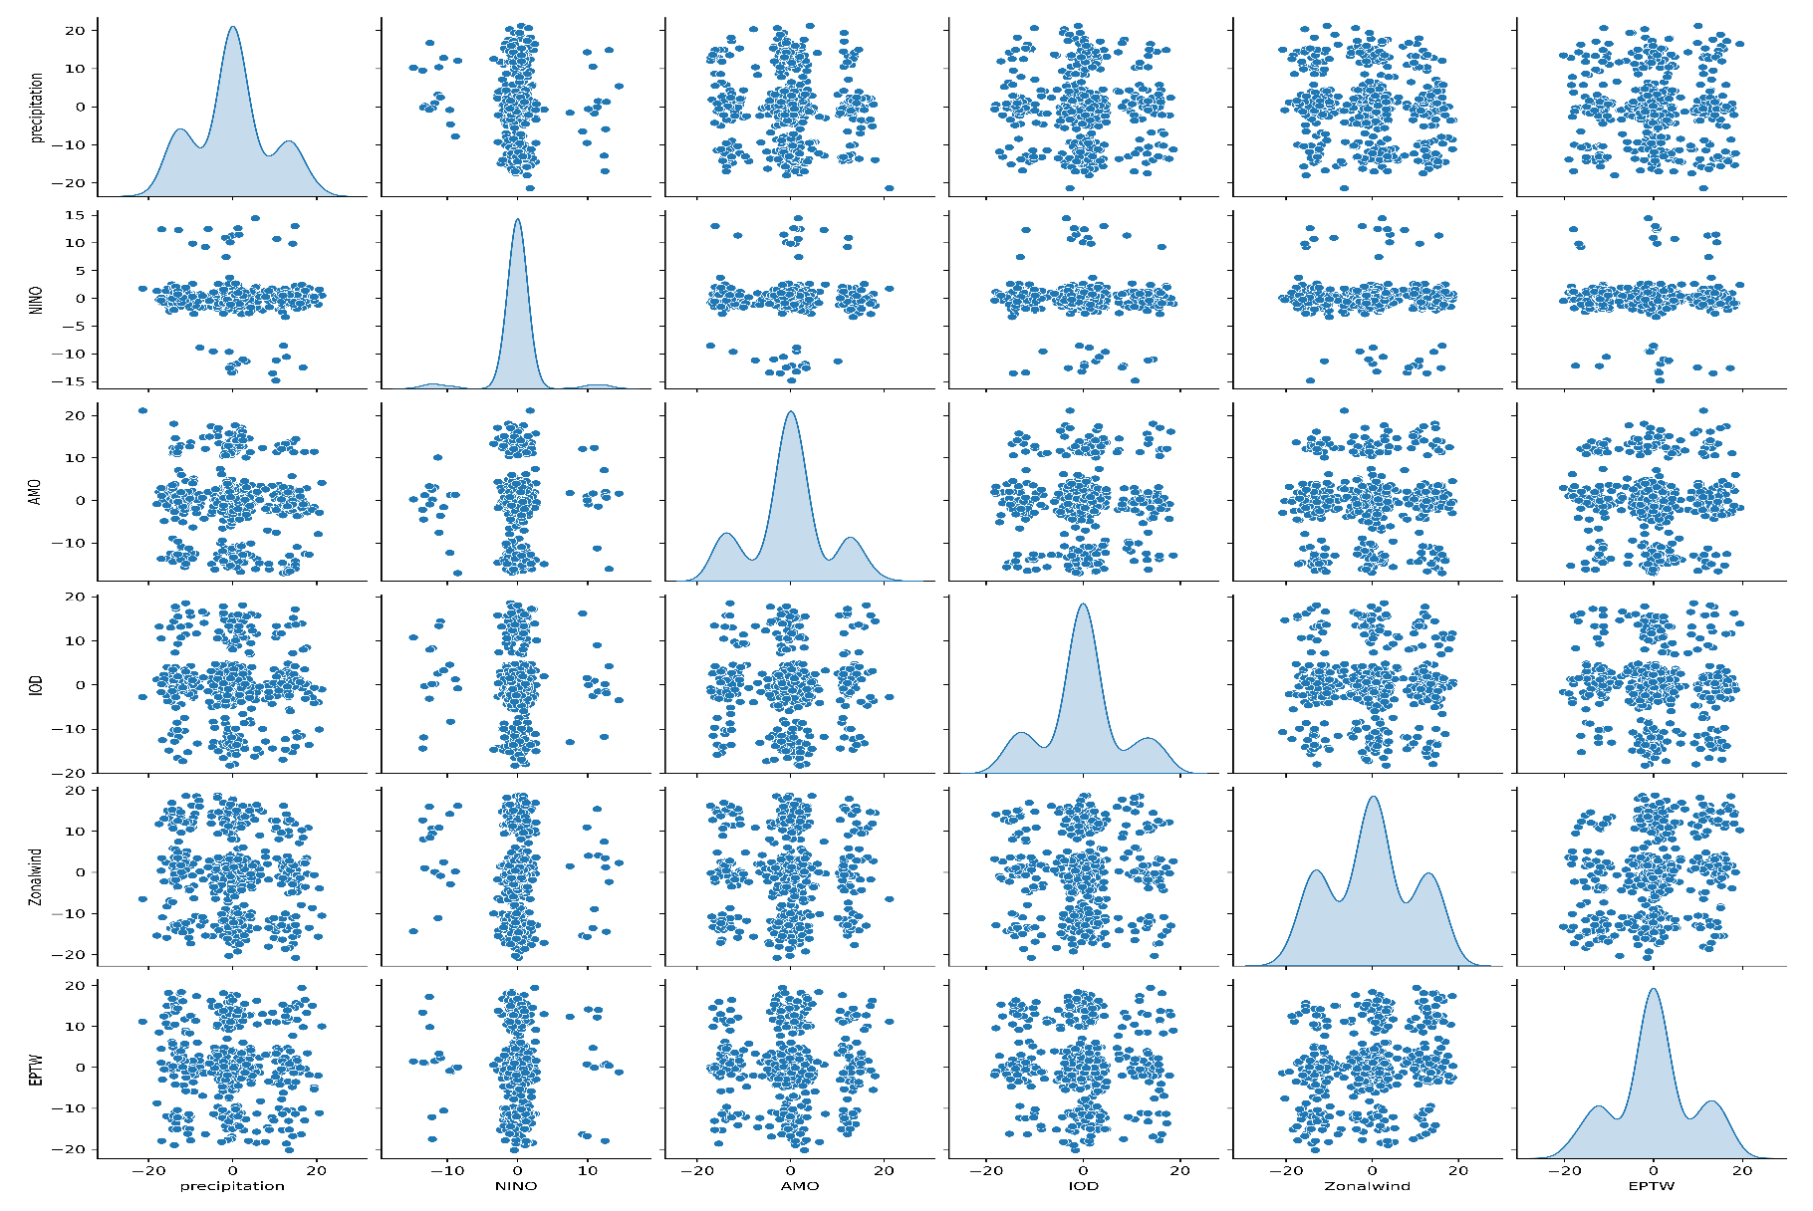
Copula
Introduction | Motivation | Objectives | Methods | Results | Outlooks

Slide 27
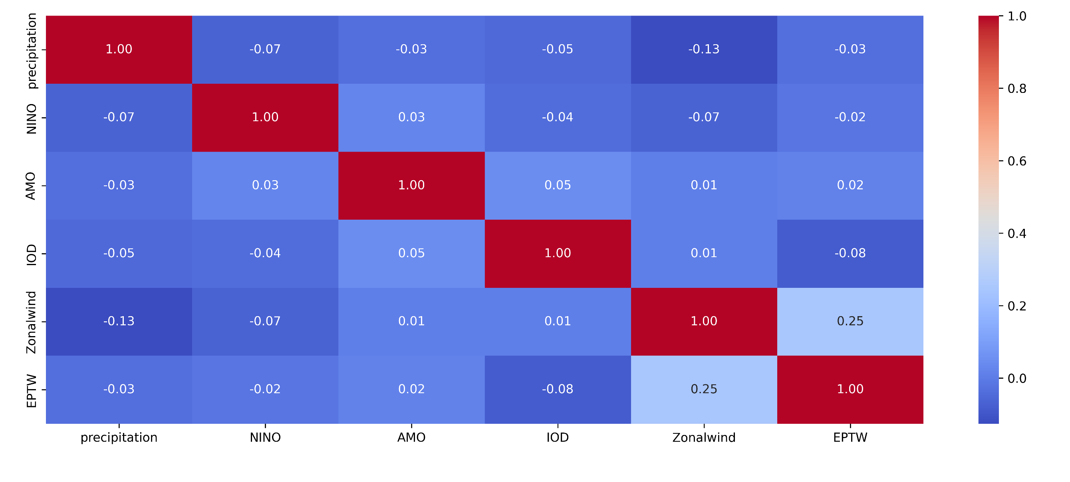
Copula
Introduction | Motivation | Objectives | Methods | Results | Outlooks

Slide 28
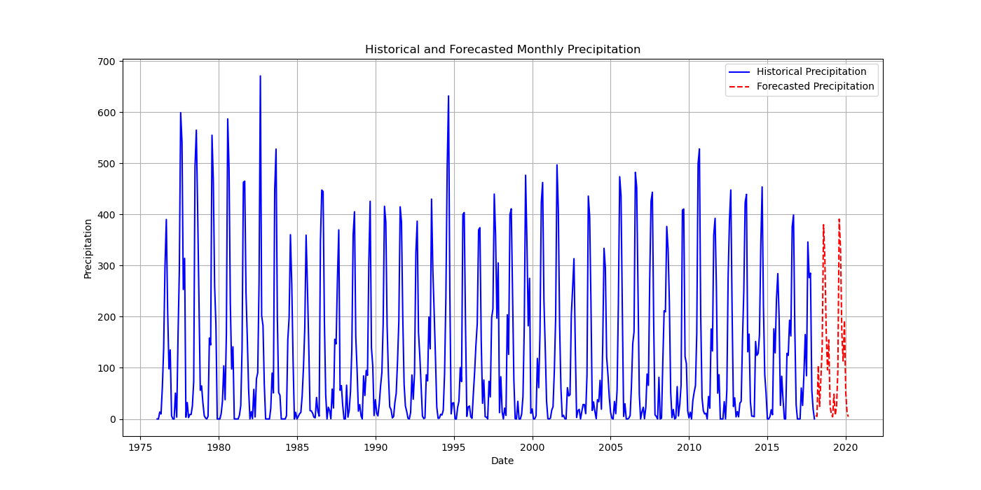
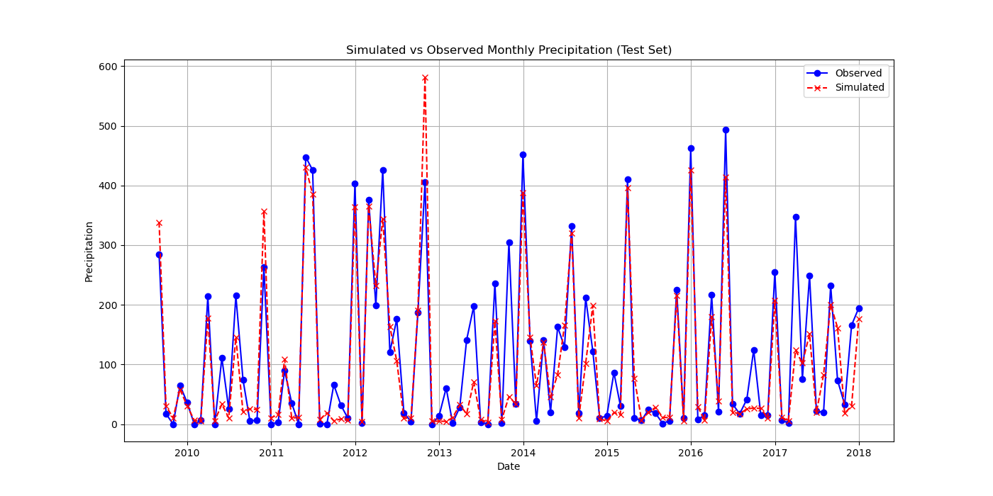
Forcast based on hitorical data -LSTM
Mean Squared Error: 0.01 R^2 Score: 0.82
Mean Squared Error: 0.01
R^2 Score: 0.82
Introduction | Motivation | Objectives | Methods | Results | Outlooks

Slide 29
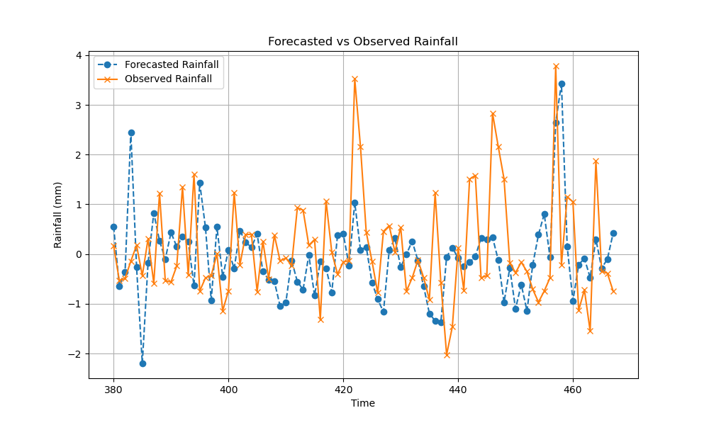
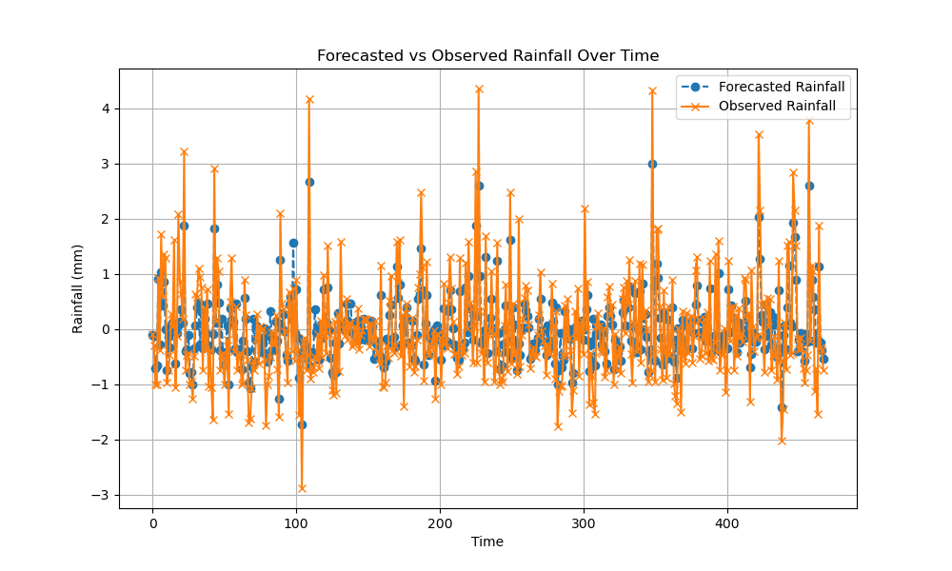
Forecast using climate indices
LSTM
MSE: 1.5
NSE: -0.39
R-squared: -0.39
Random Forest MSE: 0.69
R^2 Score: 0.01
Introduction | Motivation | Objectives | Methods | Results | Outlooks

Slide 30
The climate system of the region has changed since 1980s.
High rainfall exterems were frequent in the climate system before 1980s; and low rainfall
exterems becomes more frequent in the current climate system.
Low temeperature exterems were frequent in the climate system before 1980s; and
high temeperature exterems becomes more frequent in the current climate system.
AMO, IOD, ENSO are the main controlling factors of the climate system of the region.
Introduction | Motivation | Objectives | Methods | Results | Conclusions

Slide 31
Thank you very much for your attention!

